Slide 1
An introduction: creating views
Bukola Olafenwa
Academic Mentor at The LETTA Trust, London
1

Slide 2
Presentation Outline
What defines a view.
Syntax for creating a view.
Creating views based on base tables.
Creating views based on other views.
Creating views to replace existing views.
Summary.
2

Slide 3

What is a view?
A virtual table.
Created based on results of SQL queries – SELECT statements.
References data mainly from base tables or other views.
Access to a view versus access to a base table(s).
Stores SELECT statements as objects in a database.
Optimises retrieval of information.
Saves time and stress.
3

Slide 4
Syntax for creating a view
Syntax
Note
CREATE VIEW view_name
AS
SELECT statement
Specify a name for the view to be created after the CREATE VIEW command;
AS keyword follows the name;
An ensuing SELECT statement.
4

Slide 5
Syntax for creating a view to replace an existing view
Syntax Note
CREATE [OR REPLACE] VIEW view_name The OR REPLACE keyword is included
AS to replace any existing view with the
SELECT statement same name in the database.
5

Slide 6


Syntax for showing views
SHOW FULL TABLES;
6

Slide 7
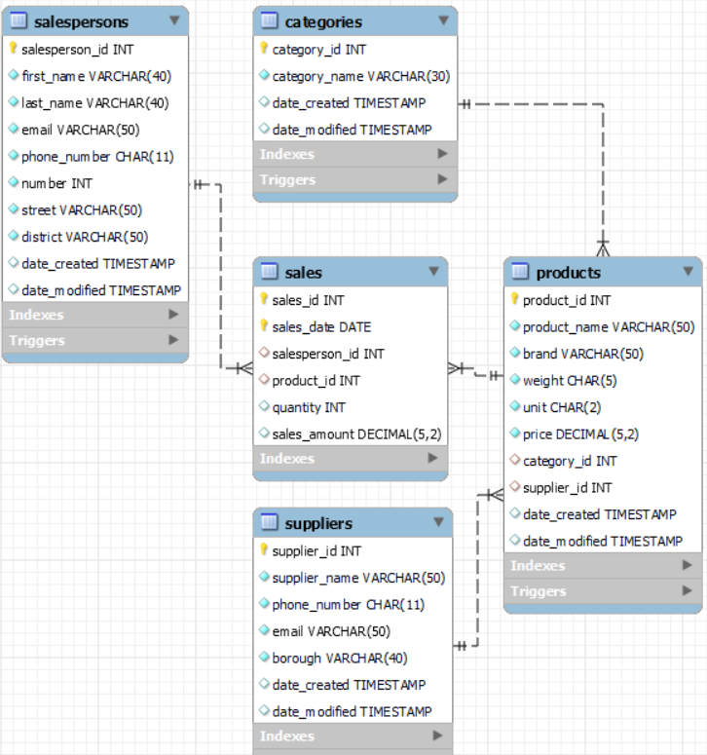
DATABASE: express_grocery
Five Tables
Categories
Products
Salespersons
Suppliers
Sales
7

Slide 8
CREATING VIEWS
EXAMPLE
List id, name and weight of products with weight exceeding 0.5 KG.
SELECT STATEMENT
SELECT product_id,
product_name,
weight
FROM products
WHERE weight > 0.5;
VIEW
CREATE VIEW halfkg_plus
AS
SELECT product_id,
product_name,
weight
FROM products
WHERE weight > 0.5;
8

Slide 9

CREATING VIEWS BASED ON BASE TABLES
Views of the following:
A list of id, name and phone number of all suppliers (supplier_details).
The total number of products in each category (prod_in_cat).
9

Slide 10

CREATING VIEWS BASED ON THE VIEWS CREATED
Views of the following:
(prod_in_cat2)
Representation of the number of products from categories with id higher than 2 (based on ‘prod_in_cat’).
(kg_range)
List the products with weight between 1 and 1.5KG (based on ‘halfkg_plus’).
10

Slide 11

CREATING VIEWS TO REPLACE EXISTING VIEWS
Views of the following (to replace some views created):
Id, name and weight of products with weight greater than 0.5 and have not been sold (to replace halfkg_plus).
Retrieve id, name and phone number of all suppliers who supply products in the ‘Frozen Foods’ category (to replace supplier_details).
11

Slide 12
SUMMARY
Views are simple to create and enable us to store SELECT statements as objects in the database for future use.
Views afford combinations of data from more than one base table or views, making frequent use of complex queries easy.
12

Slide 13
References
Bukola, O. bukola-2023/BUKOLA-PROJECTS: Bukola's Project Profile (github.com)
CFG (2023). Code First Girls (2023). Data management using SQL coding techniques.
MySQL Tutorial. MySQL CREATE VIEW (mysqltutorial.org)
Udemy. Course: The Ultimate MySQL Bootcamp: Go from SQL Beginner to Expert | Udemy
13

